Slide 1

Stakeholder Meeting at NGU Nürtingen, 24.10.205
Prof. Dr. Frank Andreas Schittenhelm

Slide 2
Stakeholder-Meeting „ESG in Bildung & Gesellschaft: Impulse – Beteiligung - Kommunikation“ ERASMUS+ Projekt BEYOND
Wann: Freitag, 24. Oktober 2025, 14:00–17:00 Uhr
Wo: Campus CI8 001 Future.Box | Hechinger Str. 12 | 72622 Nürtingen
Zeit | Programmpunkt | Referent/in | Inhalt / Anmerkungen
14:00 – 14:15 | Begrüßung & Einführung | Prof. Dr. Frank Andreas Schittenhelm | Kurzvorstellung ERASMUS+ Projekt BEYOND, Überblick über Ablauf und Zielsetzung des Meetings
14:15 – 14:25 | Impulsvortrag 1 | Britta Großmann (KEFF+) | Vorgehen bei der Projektarbeit / Einbeziehung Studierender
14:25 – 14:35 | Impulsvortrag 2 | Margarete Schumm (Energiegenossenschaft Energie für Botnang eG) | ESG in Gesellschaft und Energiegenossenschaften
14:35 – 14:45 | Impulsvortrag 3 | Nicolaus Trautwein (Commerzbank AG) | Treiber der Nachhaltigkeit aus Sicht der Commerzbank
14:45 – 14:55 | Impulsvortrag 4 | Katerina Weidle (Purem Technology GmbH) | Nachhaltigkeitsberichterstattung im Unternehmen – von der freiwilligen Berichterstattung zur Berichtspflicht
14:55 – 15:15 | Fragen & Diskussion | Alle Teilnehmenden | Austausch zu den Impulsvorträgen
15:15 – 15:35 | Kaffeepause | - | -
15:35 – 15:50 | Vorstellung Planspiel | Heiko Hammer (priME Academy gUG) | Präsentation des Planspiels priME SIM Strategic Management Professional
15:50 – 16:15 | Simulationsrunde & Diskussion | Heiko Hammer + Studierende | Praktische Demonstration des Planspiels, Feedback & Diskussion
16:15 – 16:55 | Offener Austausch & Diskussion | Alle Teilnehmenden | Identifikation von Kooperationen, Synergien und nächsten Schritten
16:55 – 17:00 | Abschluss & Verabschiedung | Prof. Dr. Frank Andreas Schittenhelm | Zusammenfassung & Abschluss

Slide 3



BEYOND: Boosting ESG Awareness in Higher Education
The BEYOND project aims to narrow the gap between EU action on environmental sustainability and its recipients. By enhancing knowledge of EU interventions and bridging the gap between demand and supply of ESG-related skills among university graduates, this initiative focuses on interdisciplinary issues related to effective implementation of EU legislation.
Integrating legal, financial, and economic expertise, BEYOND involves academics, students, professionals, investors, and businesses across Europe to promote sustainable development awareness and practices.
by LUCA SPATARO
Call 2024 Round 1 KA2 KA220-HED
Cooperation partnerships in higher education
Project: 2024-1-IT02-KA220-HED-000251303

Slide 4

Project Overview and Objectives
Enhance University Education
Raise Business Awareness
Introduce specific modules on EU sustainability in business, finance, and law courses at all education levels.
Organize training sessions for companies and professional associations on sustainable development issues.
Foster Academic Debate
Provide Stakeholder Tools
Enhance discussions on sustainable development through study meetings, workshops, and seminars.
Publish guidelines highlighting critical issues and opportunities in sustainability regulations.
Call 2024 Round 1 KA2 KA220-HED
Cooperation partnerships in higher education
Project: 2024-1-IT02-KA220-HED-000251303

Slide 5
Innovative Approach and Methodology
Active Student Involvement
Business Integration
International Perspective
Implement direct teaching methodologies like group work, seminar presentations, and experimental laboratories. Use interactive digital platforms to foster deeper and more engaging student participation.
Include businesses in the educational process, allowing students to directly engage with key players in the professional world and gain practical understanding of business dynamics related to sustainability.
Integrate diverse cultural perspectives and global contexts in learning project design, exposing students to a broader range of ideas and practices in sustainability.
Call 2024 Round 1 KA2 KA220-HED
Cooperation partnerships in higher education
Project: 2024-1-IT02-KA220-HED-000251303

Slide 6
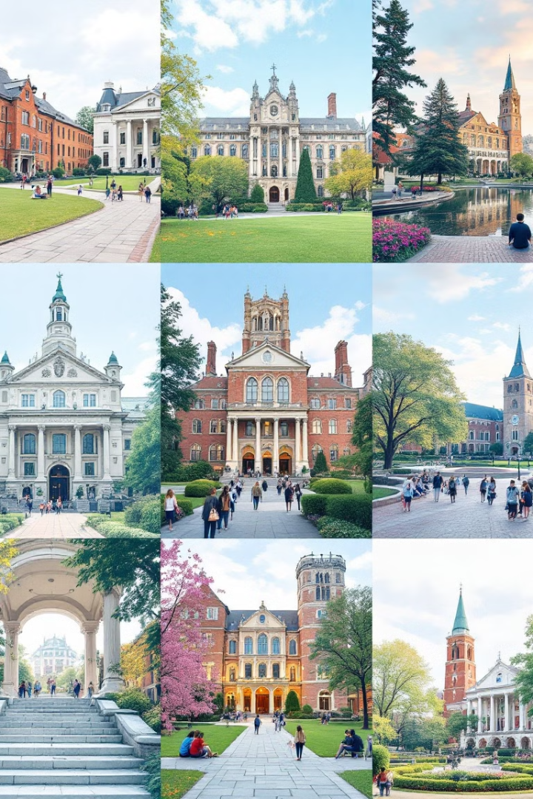




Partner Organizations and Expertise
University of Pisa
University of Messina
Lead coordinator with expertise in sustainable economics, law, and communication.
Specialized in legal and regulatory aspects of sustainability.
San Pablo-CEU University Foundation
Nuertingen-Geislingen University
Brings expertise in international sustainability perspectives.
Focused on sustainable finance and business development.
Call 2024 Round 1 KA2 KA220-HED
Cooperation partnerships in higher education
Project: 2024-1-IT02-KA220-HED-000251303

Slide 7

Work Package Overview
1
WP1: Project Management
Oversee overall project coordination, financial management, and quality assurance.
2
WP2: Participatory Analysis
Conduct research and stakeholder engagement on sustainable development in the European context.
3
WP3: Innovative Teaching
Develop and implement new teaching methods and materials focused on sustainability.
4
WP4: Communication and Dissemination
Raise awareness and share project outcomes with wider audiences.
Call 2024 Round 1 KA2 KA220-HED
Cooperation partnerships in higher education
Project: 2024-1-IT02-KA220-HED-000251303

Slide 8
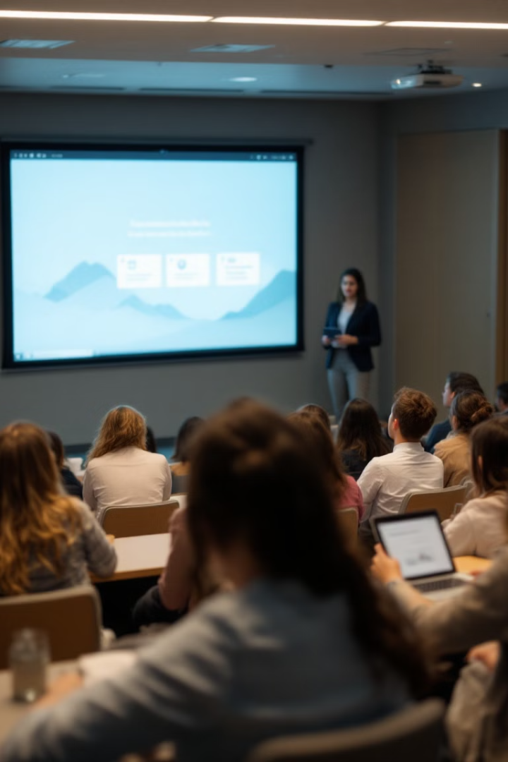
Innovative Teaching Activities
Mock Conferences
Interdisciplinary Module
Organize student-led conferences focusing on European and national approaches to sustainable growth, encouraging collaboration among universities.
Develop a new "Sustainable Corporate and Finance" teaching module, integrating societal, economic, and financial aspects of sustainable business.
Handbook Publication
Experimental Laboratories
Create a comprehensive handbook on Law, Finance, and Economics of Sustainability, serving as a key resource for students and professionals.
Implement hands-on learning experiences using cutting-edge technologies and real-world case studies in sustainability.
Call 2024 Round 1 KA2 KA220-HED
Cooperation partnerships in higher education
Project: 2024-1-IT02-KA220-HED-000251303

