Slide 1
“
“
Sustainable finances are the fuel for green economy
~ Frans Timmermans

Slide 2
ESG Investments & Greenwashing

Slide 3
Outline
ESG regulations & ratings
Greenwashing
Solutions for Greenwashing

Slide 4
ESG regulation & ratings
EU Regulations
Rating agencies
EU taxonomy
Disclouser regulation (SFDR)
Article 6,8 & 9 funds
Corporate sustainability initiative (CSDR)
MSCI ESG research
Sustainalytics
ISS ESG

Slide 5
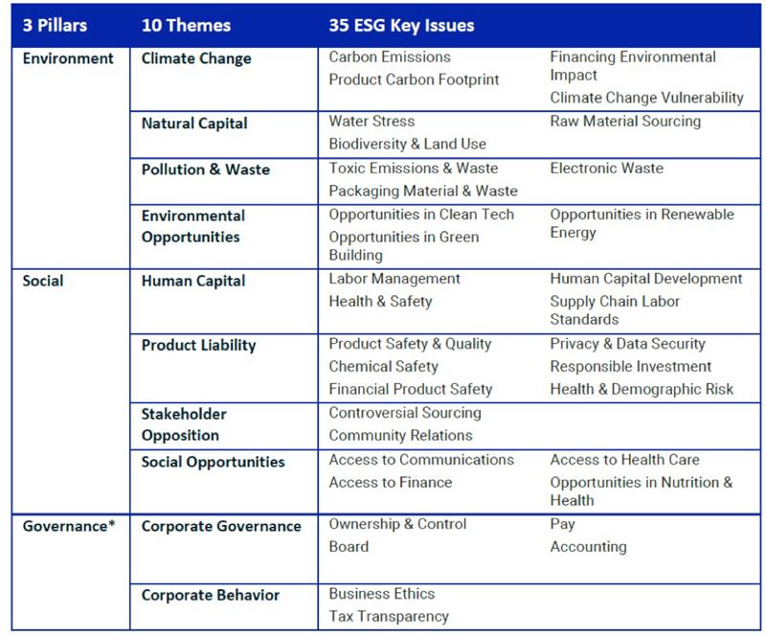
MSCI ESG criterias

Slide 6
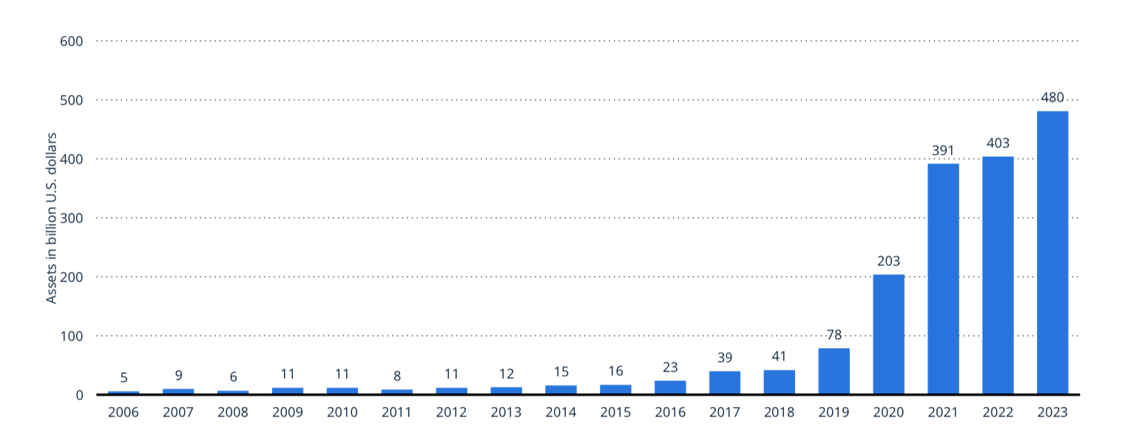
Development global ESG ETF assets

Slide 7
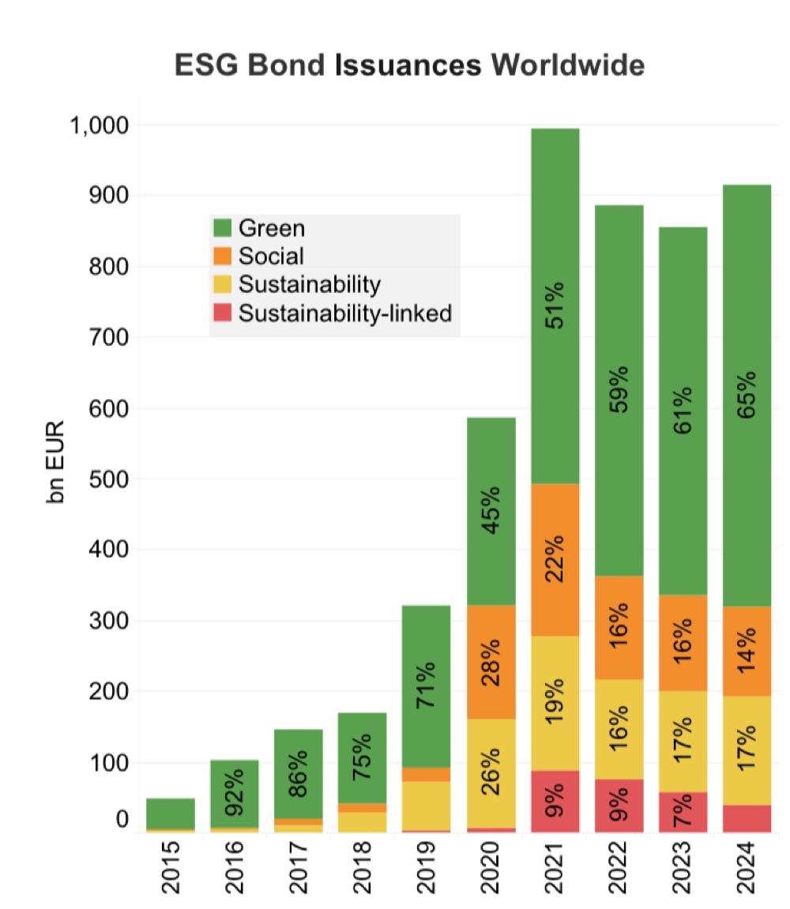
ESG Bond issuances worldwide

Slide 8
Greenwashing definition

Slide 9
The 7 sins of Greenwashing
1. Hidden trade-off
2. No proof
3. Vagueness
4. Irrelevance
5. Lesser of two evils
7. Worshiping false labels
6. Fibbing

Slide 10
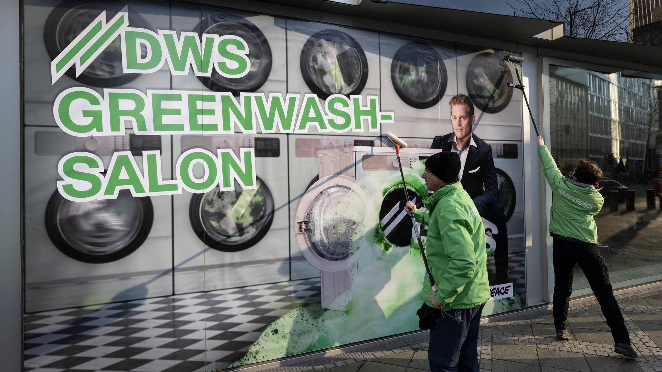


Greenwashing example: DWS Group
2021: Whistleblower Desiree Fixler exposed ESG exaggerations
Investigations: SEC, FBI, Bafin → 2022 raid, CEO resigned
ESG claims: €459bn (2020) → €115bn (2021)
Fines: $19m (SEC, 2023), €25m (Prosecutor, 2025)
picture alliance/dpa | Boris Roessler

Slide 11
Number of ESG funds invested in controversial and non-controversial companies
Own representation with statista data

Slide 12
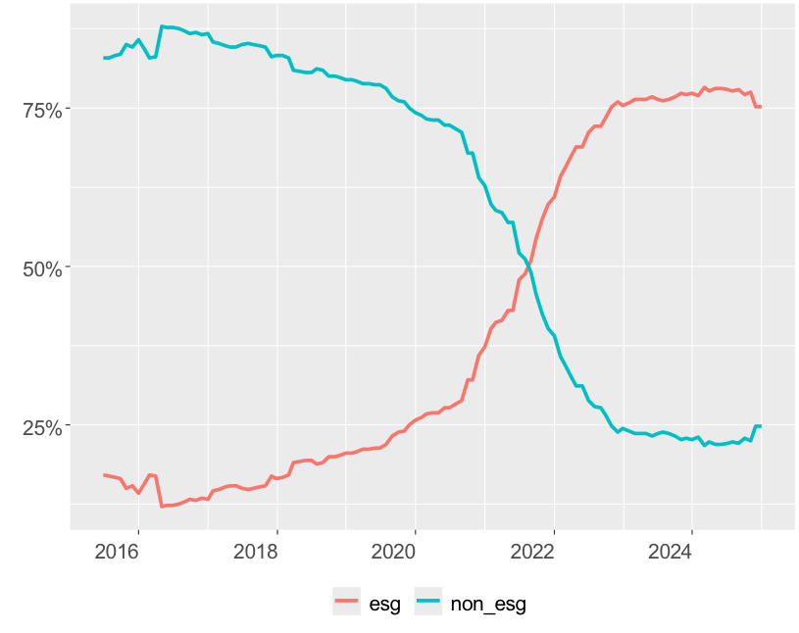

Change of labels from ESG funds

Slide 13
Solutions for greenwashing
Clearer understanding of term Greenwashing
Standardized system for rating agencies for ESG Criteria
Regulations for social and governance
Support for initatives with mandatory self-regulation
Higher transparacy for rating agencies & investment advisor

Slide 14
Sources
Anzahl der ESG-Fonds, die in kontroverse und in nicht kontroverse Unternehmen investiert werden. (02. 01 2024). Von Statista: https://de.statista.com/statistik/daten/studie/1309992/umfrage/esg-fonds-die-in-kontroverse-unternehmen-investiert-werden/ abgerufen 08.04.2025
Dahl, R. (2010). Greenwashing do you know what you´re buying? EHP Publishing.
Division, M. I. (2025). ESG Bond Monitor. Market Intelligence.
EU taxonomy for sustainable activities. (2025). Von European Comission: https://finance.ec.europa.eu/sustainable-finance/tools-and-standards/eu-taxonomy-sustainable-activities_en abgerufen 08.04.2025
Global ESG ETF assets from 2006 to November 2023. (10. 10 2024). Von Statista: https://www.statista.com/statistics/1297487/assets-of-esg-etfs-worldwide/ abgerufen 08.04.2025
Koch, M., & Kruse, J. (2024). Greenwashing bei Geldanlagen. In M. Hiller, K. Krüger, T. Riedel, T. Schempf, V. Steinhübel, & O. Zeitnitz, Finance-Perspektiven im Wandel (S. 119-137). Riedlingen: Springer Verlag.
Methodik. (2025). Von Fair Fonds: https://www.faire-fonds.info/methodik/ abgerufen 08.04.2025
Müllauer, A. (2022). ESG Rating Kriterien unter der Lupe - Effektivität der ESG-Kriterien hinsichtlich Nachhaltigkeit. Wien: FH Wien.
Osman, Y., & Votsmeier, V. (02. 04 2025). Staatsanwaltschaft verhängt Millionenbußgeld gegen DWS. Handelsblatt.
Ruppert, B. (2024). Greenwashing, Ratings und Siegel. In B. Ruppert, Impact Investing (S. 135-154). Stuttgart: Schäffer-Poeschl Verlag.
Sustainability-related disclosure in the financial services sector. (2025). Von European Comission: https://finance.ec.europa.eu/sustainable-finance/disclosures/sustainability-related-disclosure-financial-services-sector_en abgerufen 08.04.2025
terrachoice. (2010). The sins of greenwashing. Underwriters Labatories.

Slide 15
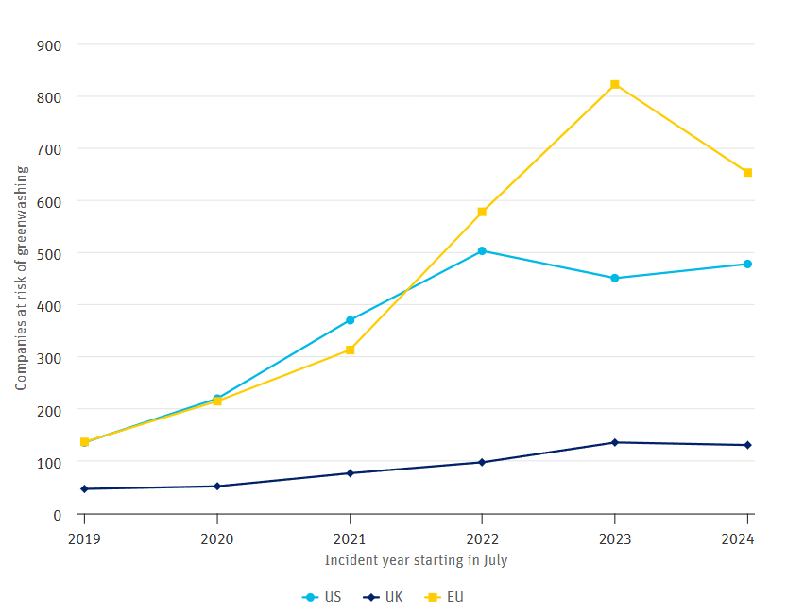
Greenwashing shift in major markets: A closer look at US, UK, and EU
(Mathias Fürer, 2024)

